Slide 1

A Graph Convolutional Neural Network (GCNN) Modelling for Hub-Gene identification in Alzheimer’s Disease Using Integrated Co-expression and Protein-Protein Interaction(PPI) analysis with Cross-Dataset Validation.
Presented by
FALGUNI YADAV (UG/02/BTCSE/2022/012)
RUCHI SINGH (UG/02/BTCSE/2022/054)
CHAITI BAIN (UG/02/BTCSE/2022/055)
Under the supervision of
Mr. Arup Mallick
Assistant Professor
Department of Computer Science and Engineering
Adamas University

Slide 2
PROBLEM STATEMENT
• Lack of Reliable Hub Gene Identification in Alzheimer’s Disease Existing gene analysis methods often fail to consistently identify important hub genes associated with Alzheimer’s disease.
• Difficulty in Capturing Complex Gene Interactions Alzheimer’s disease involves multiple interacting genes and biological pathways that traditional analytical approaches cannot effectively model.
• Limitations of Conventional Gene Expression Analysis Traditional methods cannot capture complex relationships within gene co-expression and protein–protein interaction networks.
• Need for Advanced Computational Approaches Advanced models such as Graph Convolutional Neural Networks (GCNN) are required to analyze gene networks and identify key hub genes more accurately.

Slide 3
OBJECTIVES
• Analysis of Alzheimer’s Disease Gene Expression Data To analyze Alzheimer’s disease gene expression datasets obtained from the GEO database.
• Identification of Differentially Expressed Genes (DEGs) To detect genes that show significant differences in expression between Alzheimer’s disease and control samples.
• Construction of Gene Interaction Networks To build gene interaction networks by integrating co-expression relationships and protein–protein interaction (PPI) data.
• Application of Graph Convolutional Neural Network (GCNN) To apply a GCNN model for analyzing the gene interaction network and learning complex relationships among genes.
• Identification of Key Hub Genes To identify highly influential hub genes that may play an important role in the development and progression of Alzheimer’s disease.

Slide 4
RESEARCH GAP
LIMITED CROSS-DATASET REPRODUCIBILITY
most existing ad gene identification studies rely on single-cohort analysis and lack validation across independent datasets, reducing reliability.
INADEQUATE MODELING OF COMPLEX GENE NETWORKS
traditional statistical and differential expression methods fail to capture nonlinear and higher-order interactions within biological networks.
POOR INTEGRATION OF MULTI-SOURCE BIOLOGICAL DATA
many approaches do not effectively combine gene expression data with protein–protein interaction (ppi) networks and prior biological knowledge.
LACK OF INTERPRETABILITY IN DEEP LEARNING MODELS
existing deep learning models often act as black boxes, providing limited insight into gene-level contributions and biological mechanisms.
INSUFFICIENT TRANSLATION TO THERAPEUTIC TARGET DISCOVERY
few computational pipelines systematically connect predicted disease genes to experimentally testable therapeutic hypotheses.

Slide 5
LITERATURE REVIEW
Ref. | Paper Name | Method | Contribution | Research Gap
Zhang & Kiryu, 2023 (Scientific Reports) | Identification of oxidative stress-related genes differentially expressed in Alzheimer’s disease and construction of a hub gene-based diagnostic model | DEG analysis (Limma), WGCNA, PPI network (STRING), ROC analysis, LASSO regression | Identified 5 oxidative stress-related hub genes (MAPK9, FOXO1, BCL2, ETS1, SP1) and developed a 5-gene diagnostic model (AUC = 0.88 validation) | Lack of experimentally validated oxidative stress biomarkers; need clinical validation;
Cheng et al., 2021 (American Journal of Alzheimer’s Disease & Other Dementias®) | Identification of Hub Genes Related to Alzheimer’s Disease and Major Depressive Disorder | GEO dataset analysis, DEG screening (Limma), TF–gene & miRNA–gene networks; ROC analysis | Identified 79 shared DEGs between AD and MDD, Validated gene expression after venlafaxine treatment | Lack of brain tissue datasets for MDD; Small validation sample size; No experimental (in vivo/in vitro) validation

Slide 6
LITERATURE REVIEW
Ref. | Paper Name | Method | Contribution | Research Gap
Zhao et al., 2022 (Frontiers in Aging Neuroscience) | Integrated analysis and identification of hub genes as novel biomarkers for Alzheimer’s disease | GEO dataset analysis, DEG screening (Limma); Immune-related gene intersection. | Identified 153 immune-related DEGs; Discovered 5 hub genes , Identified AGAP3 as key diagnostic biomarker | Lack of experimental validation, Limited clinical data in GEO datasets; Small sample diversity; Mechanistic role of AGAP3 in AD progression not fully explored
Abd ul Kader et al., 2024 (Journal of Kufa for Mathematics and Computer) | Abd ul Kader et al., 2024 (Journal of Kufa for Mathematics and Computer) | Constructed weighted Protein–Protein Interaction (PPI) network (HPRD + GWAS), HITS algorithm | Proposed improved HITS-based weighted PPI approach; Identified top 10 AD hub genes , Integrated biological data with network topology | No experimental (wet-lab) validation of identified genes; Limited to PPI and GWAS datasets; Clinical applicability not validated.

Slide 7
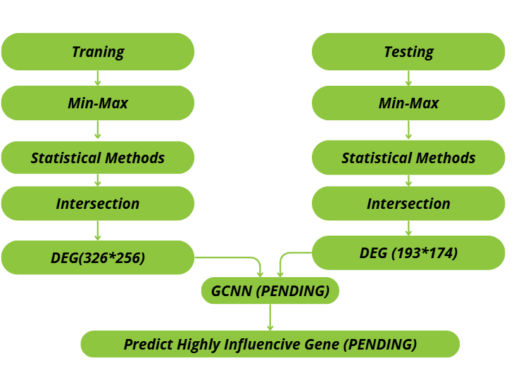
WORKFLOW DIAGRAM

Slide 8
METHODOLOGY
Alzheimer’s Disease gene expression datasets (GSE48350 and GSE11882) are taken from the GEO database
The datasets contain gene expression values from Alzheimer’s patients and healthy control samples
Probe IDs are converted into gene names, and only common genes in both datasets are selected
Batch differences between datasets are removed to make them comparable
Min–Max normalization is applied to scale all gene expression values between 0 and 1
Statistical tests (T-test, ANOVA, and Limma) are used to find genes that show significant differences between AD and control groups

Slide 9
METHODOLOGY
A gene interaction network is created using co-expression relationships and protein–protein interaction (PPI) data
Each gene is given features such as average expression, fold change, and variance
A Graph Convolutional Neural Network (GCNN) is used to analyze both gene features and their connections
Known Alzheimer’s-related genes are used as reference labels to train the model
The model is tested across datasets (train on one dataset and test on another) to check reliability
Genes with high prediction scores and strong network importance are selected as potential hub genes
Finally, pathway analysis is performed to confirm whether these genes are related to Alzheimer’s biological processes

Slide 10
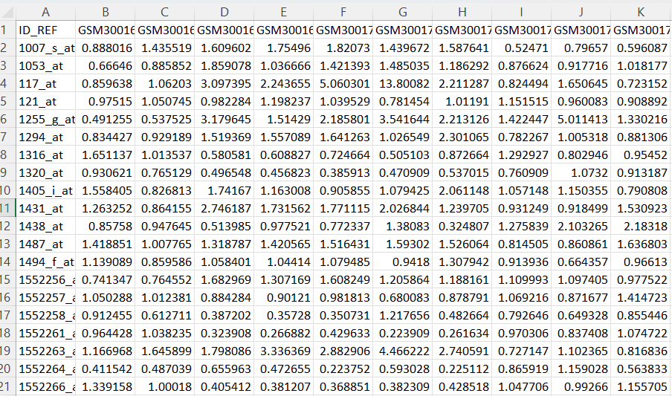
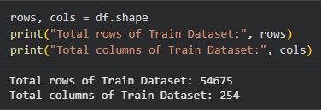
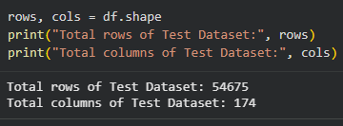
DATASET COLLECTION
Datasets obtained from National Center for Biotechnology Information (NCBI)
Website: https://www.ncbi.nlm.nih.gov
Accessed through Gene Expression Omnibus (GEO)
Website: https://www.ncbi.nlm.nih.gov/geo/
Selected datasets:
GSE48350
GSE11882
Microarray-based gene expression data
Includes Alzheimer’s disease and control samples
Expression matrices downloaded for preprocessing

Slide 11





TOOLS & TECHNOLOGY
1 Programming Language
Python
2 Development Environment
Google Colab
3 Data Source
National Center for Biotechnology Information Gene Expression Omnibus
4 Datasets Used
GSE48350
GSE11882
5 Libraries & Packages
NumPy – numerical computation
Pandas – data preprocessing
SciPy – t-test analysis
Statsmodels (sm) – OLS modeling
6 Statistical Methods
t-test
Anova
LIMMA test (Linear Model–based approach)

Slide 12
SYSTEM ARCHITECTURE
NCBI / GEO
↓
Data Extraction
↓
Data Cleaning
↓
Min-Max Normalization
↓
Statistical Testing
↓
Intersection of Significant Probes

Slide 13
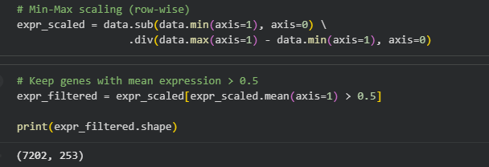
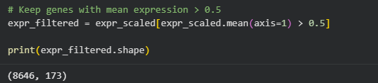
IMPLEMENTATION
Collected datasets from Gene Expression Omnibus (GSE48350 and GSE11882)
Extracted and structured expression matrices
Cleaned the data by removing missing and duplicate entries
Applied Min-Max normalization to scale expression values between 0 and 1
Performed statistical analysis using:
t-test
ANOVA
LIMMA-inspired linear model (OLS using Statsmodels)
Obtained significant probe sets from each dataset
Performed intersection to identify common significant probes
Train filtered dataset
Test filtered dataset

Slide 14
CONCLUSION
The proposed GCNN-based framework successfully identified biologically meaningful and reproducible Alzheimer’s disease hub genes from integrated multi-cohort data.
Cross-dataset transfer validation demonstrated strong robustness and generalization without model refitting.
Attribution analysis improved interpretability by quantifying each gene’s contribution to disease prediction.
The prioritized hub genes showed significant enrichment in key AD-related pathways (synaptic signaling, neuroinflammation, and mitochondrial dysfunction), supporting biological relevance and therapeutic potential.

Slide 15
References
1. Al-Shoukry, S., Rassem, T. H., & Makbol, N. M. (2020). Alzheimer’s diseases detection by using deep learning algorithms: a mini-review. IEEE Access, 8, 77131–77141. https://doi.org/10.1109/ACCESS.2020.298939
2. Arya, A. D., Singh Verma, S., Chakrabarti, P., Chakrabarti, T., Elngar, A. A., Nami, M., et al. (2023). A systematic review on machine learning and deep learning techniques in the effective diagnosis of Alzheimer’s disease. Brain Informatics, 10(17). https://doi.org/10.21203/RS.3.RS-2028945
3. El-Gawady, A., Makhlouf, M. A., Tawfik, B. S., & Nassar, H. (2022). Machine Learning Framework for the Prediction of Alzheimer’s Disease Using Gene Expression Data Based on Efficient Gene Selection. Symmetry, 14(3), 491. https://doi.org/10.3390/sym14030491
4. Mahendran, N., Vincent, P. M. D. R., Srinivasan, K., & Chang, C.-Y. (2021). Improving the Classification of Alzheimer’s Disease Using Hybrid Gene Selection Pipeline and Deep Learning. Frontiers in Genetics, 12, 784814. https://doi.org/10.3389/fgene.2021.784814
5. Ray, S., et al. (2017). A comprehensive analysis on preservation patterns of gene co-expression networks during Alzheimer’s disease progression. BMC Bioinformatics, 18, 579. https://doi.org/10.1186/s12859-017-1946-8
6. Sims, J. R., et al. (2023). Donanemab in early symptomatic Alzheimer disease: The TRAILBLAZER-ALZ 2 randomized clinical trial. JAMA.

Slide 16
thank you

